Slide 1


Scrum Agile Methodology
Samantha Pollard
CS499- Capstone July 2022

Slide 2


Roles
The Organization that is Scrum –Agile

Slide 3
Scrum Product owner: Key Roles & Responsibilities
Scrum Product Owner
Managing and prioritizing the product back-log
Translating product managers strategies to task for development
Learning the market and customers’ needs
Serving as a liaison between product and development
Staying accessible to development in order to answer questions
Overseeing the development stages

Slide 4
Scrum Team Roles : The Developers
The Developers
Achieve the goals defined for each sprint
Attend the daily scrum meetings reporting the planned tasks for each day
Assure to Product Owner and Scrum Master that the allocated work is being performed as planned
Ensure a clear understanding of epics and personas
Provide inputs on the creation of User Stories to the Product Owner
Understand the User Stories
Estimate user stories provided by the Product Owner
Commit User Stories to be done in a sprint and develop the list of tasks based on the User Story.

Slide 5
Role of a Scrum Master
Formulating techniques for effective Product Backlog Management
Helps team understand the need for clear and concise product backlog items
Removing project impediments that stand in the way of team productivity and performance.
Creating transparency in processes and resolving conflicts
Facilitating Scrum events as requested or needed
Helping employees and stakeholders understand and implement Scrum practices
Acting as a change agent that increases the productivity of the team
Supports the PO and acts as a bridge between the PO team and organization.

Slide 6
Role of a Scrum Master cont…
Coordinates activities on the ART and prepares for ART events.
Works in tandem with other Scrum Masters on other teams to improve the overall value system.
Helps the team to drive relentless improvement and progress toward goals
Hosts and facilitates Scrum events
Removes Obstacles
Promotes SAFe practices and supports SAFe adoption across the enterprise.

Slide 7
Software Development Life Cycle Process Changes (SDLC)
SCRUM/Agile Workflow

Slide 8
Process of Software Development: Life Cycle
2. Analysis Stage
3. Design Stage
1. Planning Stage
7. Maintenance Stage
4. Development Stage
6. Integration Stage
5. Testing Stage

Slide 9
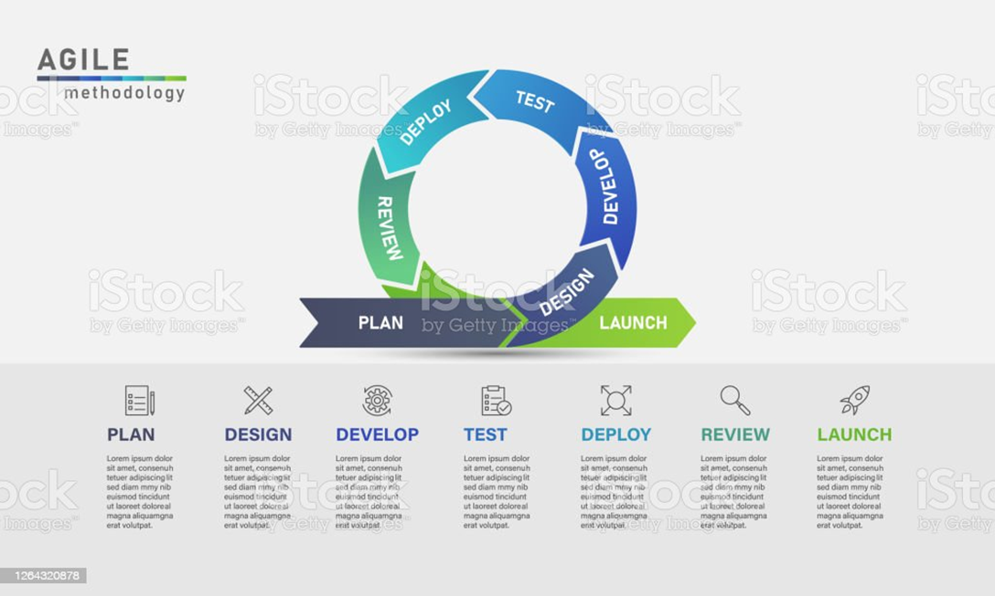
Phases of Software Development : Agile
Requirement Gathering:
During this phase, detailed requirements of software to be developed are gathered from client
System Design:
Plan the programming language( Java, PHP,. Net, Oracle, MySQL)
Implementation
After design stage , it is a build stage, that is nothing but coding the software.
System Testing
This phase , you test the software to verify that it is built as per the specifications given
System Deployment
Deploy the application in the respective environment
System Maintenance
The system is ready to use so that later required change of the code can be made per the customers request.

Slide 10
What to consider when choosing between Agile and waterfall
How to choose which program is best for your team.
Waterfall
It’s a well-defined methodology that has been used in all business verticals. It’s a tried-and-true methodology that is straightforward and expectations are clear.
The methodology defines what you are building to a very detailed level at the beginning of the process. This makes setting deliverable dates, start/end dates, milestone planning, as well as the team’s ability to track progress much easier.
Developers and testers can focus on writing code and writing test cases. They don’t have to work with stakeholders to determine what the product requirements are.
What the team is going to deliver is more predictable. Because the product requirements are documented and approved prior to the beginning of development, there is a commitment to deliver a specific set of features which makes the final product more predictable.

Slide 11
What to consider when choosing between Agile and waterfall
Agile offers flexibility. One of the foundational elements of agile is that the methodology offers a flexible approach to software development. Priorities and requirements can easily be adjusted throughout the project to meet the needs of the stakeholders.
Agile empowers the team. The cross-functional team works as a unit to define, design and build the software product. The team is expected to be self-organized and is not directed by a manager. This allows team members to define and deliver their own work as they see fit. The team is given the responsibility to deliver the project, which empowers them.
Time to market is accelerated. With Agile projects, there is more focus on what needs to be done and less of a focus on planning and documentation. The team’s energy is spent on developing the software product and delivering working software with each iteration or sprint.
Learning is encouraged and embraced. Learning is part of the process – the product is defined as the team iterates. This allows the team to learn, adjust course and improve through the project. Sprint retrospectives, a process fundamental to Agile, are used to gather feedback from the team on how they can improve to deliver software more quickly and with better quality.

Slide 12
References
Martin, M. (2022, July 15). What is waterfall model in SDLC? advantages and disadvantages. Guru99. Retrieved August 12, 2022, from https://www.guru99.com/what-is-sdlc-or-waterfall-model.html
The Agile Software Development Life Cycle: Wrike Agile Guide. Wrike. (n.d.). Retrieved August 12, 2022, from https://www.wrike.com/agile-guide/agile-development-life-cycle/
Agile model (software engineering) – java point. www.javatpoint.com. (n.d.). Retrieved August 12, 2022, from https://www.javatpoint.com/software-engineering-agile-model#:~:text=%22Agile%20process%20model%22%20refers%20to,beginning%20of%20the%20development%20process.

